Slide 1
CH 5
Relational Database Design

Slide 2
Design guidelines for relational Schema
Semantic of the relation attributes
Do not mix attributes from distinct real
world
Design a relation schema so that it is easy to explain its meaning.
Do not combine attributes from multiple entity types and relationship types into a single relation.

Slide 3
If a relation schema corresponds to one entity type or one relationship type,
it is straightforward to explain its meaning.
Otherwise, if the relation corresponds to
a mixture of multiple entities and relationships

Slide 4
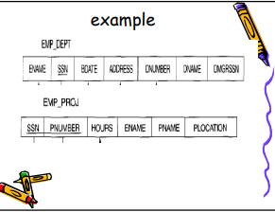

Slide 5
A tuple in the EMP_DEPT relation
schema represents a single employee
but includes additional information ,
the name (DNAME) of the department for which the employee works and
the social security number (DMGRSSN) of the department manager

Slide 6
For the EMP_PROJ relation, each tuple relates an employee to a project but also includes
– the employee name (ENAME),
– project name (PNAME),
– project location (PLOCATION).

Slide 7
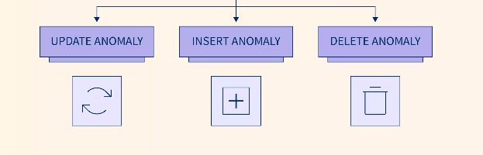
Anomalies

Slide 8
What are the Anomalies in DBMS?
Normalization is required to organise data in a database. If it is not done, the overall data integrity in the database will deteriorate over time.
This is related to data abnormalities.
These DBMS anomalies are common, and they result in data that doesn’t match with what the real-world database claims to reflect.
When there is too much redundancy in the information present in the database, anomalies occur.

Slide 9
Update anomaly:
In the above table we have two rows for employee Rick as he belongs to two departments of the company.
If we want to update the address of Rick then we have to update the same in two rows or the data will become inconsistent.
If somehow, the correct address gets updated in one department but not in other then as per the database, Rick would be having two different addresses,which is not correct and would lead to inconsistent data.

Slide 10
Insert anomaly:
Suppose a new employee joins the company, who is under training and currently not assigned to any department then we would not be able to insert the data into the table if emp_dept field doesn’t allow nulls.

Slide 11
Delete anomaly:
Suppose, if at a point of time the company closes the department D890 then deleting the rows that are having emp_dept as D890 would also delete the information of employee Maggie since she is assigned only to this department.
To overcome these anomalies we need to normalize the data for this we need normalization.

Slide 12
1. Due to _______, the database design precludes some data from being stored.
a. Insertion Anomalies
b. Deletion Anomalies
c. Selection Anomalies
d. Update Anomalies

Slide 13
3. What are the different types of relationships produced by the technique in order to prevent modification anomalies?
a. Referential integrity constraints
b. Functional dependencies
c. Normal forms
d. None of the above

Slide 14
What is Functional Dependency in DBMS?
If X is a relation that has attributes P and Q, then their functional dependency would be represented by -> (arrow sign)
Thus, here, the following would represent the functional dependency between the attributes using an arrow sign:
P -> Q

Slide 15
In this case, the left side of this arrow is a Determinant.
The right side of this arrow is a Dependent.
P will be the primary key attribute, while Q will be a dependent non-key attribute from a similar table as the primary key.
Conclusion
It shows that non-key attribute Q is functionally dependent on primary key attribute P.

Slide 16
Example
Let us look at an example that makes it easier to comprehend functional dependency.
Suppose we have a <Student> table with two separate attributes − Stu_Id and Stu_Name.
Stu_Id = Student ID
Stu_Name = Student Name
The StuId is our primary key. And StuId here identifies the StuName attribute uniquely. It is because if someone wants to know the student’s name, then you need to have the StuId at first.

Slide 17
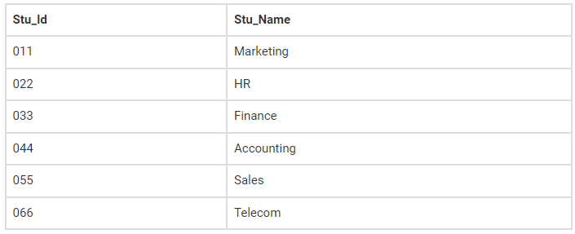
Stu_Id -> Stu_Name
Conclusion
It shows that non-key attribute stud_name is functionally dependent on primary key attribute stud_id.

Slide 18
Types of Functional Dependencies
Functional Dependencies are of four major types:
Trivial FD
Non-Trivial FD
Completely Non-Trivial FD

Slide 19
1. Trivial Functional Dependency
A trivial functional dependency occurs when Q is a subset of P in −
P ->Q
Example,
Let us now consider the same <Section> table with two separate attributes to comprehend the trivial dependency’s concept. Here is a trivial functional dependency because SecId is a subset of SecId and SecName.
{ Sec_Id, Sec_Name } -> Sec Id

Slide 20
2. Non –Trivial Functional Dependency
A non-trivial functional dependency occurs when Q is not a subset of P in −
P -> Q
Example,
Sec_Id -> Sec_Name
The FD given above is that of a non-trivial type since SecName is not a subset of SecId.

Slide 21
3. Completely Non-Trivial Functional Dependency
A completely non-trivial functional dependency occurs when P intersection Q is null then this dependency is said to be completely non trivial functional dependency −
P -> Q

Slide 22
Functional Dependency’s Armstrong’s Axioms Property
Armstrong's Axioms is a set of rules.
It provides a simple technique for reasoning about functional dependencies.
It was developed by William W. Armstrong in 1974.
It is used to infer all the functional dependencies on a relational database.

Slide 23
A. Primary Rules
This property suggests those rules that hold true only when the following ones are satisfied:
Augmentation
If A hold B and C is a set of attributes, then AC holds BC. {AC → BC}
It means that attribute in dependencies does not change the basic dependencies.

Slide 24
Reflexivity
If A is a set of attributes and B is a subset of A, then A holds B. { A → B }

Slide 25
Transitivity
If A holds B and B holds C, then A holds C.
If {A → B} and {B → C}, then {A → C}
A holds B {A → B} means that A functionally determines B.

Slide 26
B. Secondary Rules
Union
If A holds B and A holds C, then A holds BC.
If{A → B} and {A → C}, then {A → BC}
Decomposition
If A holds BC and A holds B, then A holds C.
If{A → BC} and {A → B}, then {A → C}

Slide 27
Pseudo Transitivity
If A holds B and BC holds D, then AC holds D.
If{A → B} and {BC → D}, then {AC → D}

Slide 28
Example:
Consider relation E = (P, Q, R, S, T, U) having set of Functional Dependencies (FD).
P → Q P → R
QR → S Q → T
QR → U PR → U
Calculate some members of Axioms are as follows,
1. P → T
2. PR → S
3. QR → SU
4. PR → SU

Slide 29
Solution:
1. P → T
In the above FD set, P → Q and Q → T
So, Using Transitive Rule: If {A → B} and {B → C}, then {A → C}
If P → Q and Q → T, then P → T.
P → T

Slide 30
2. PR → S
In the above FD set, P → Q
As, QR → S
So, Using Pseudo Transitivity Rule: If{A → B} and {BC → D}, then {AC → D}
If P → Q and QR → S, then PR → S.
PR → S

Slide 31
3. QR → SU
In above FD set, QR → S and QR → U
So, Using Union Rule: If{A → B} and
{A → C}, then {A → BC}
If QR → S and QR → U, then QR → SU.
QR → SU
4. PR → SU

Slide 32
4. PR → SU
So, Using Pseudo Transitivity Rule:
If{A → B} and {BC → D}, then {AC → D}
If PR → S and PR → U, then PR → SU
PR → SU

Slide 33
Improving the Design of a Database
Evaluate Primary Key Assignments
Evaluate Naming Conventions
Refine Attributes
Identify New Attributes
Identify New Relationships

Slide 34
Normalization
A large database defined as a single relation may result in data duplication. This repetition of data may result in:
Making relations very large.
It isn't easy to maintain and update data as it would involve searching many records in relation.
Wastage and poor utilization of disk space and resources.
The likelihood of errors and inconsistencies increases.

Slide 35
So to handle these problems, we should analyze and decompose the relations with redundant data into smaller, simpler, and well-structured relations that are satisfy desirable properties.
Normalization is a process of decomposing the relations into relations with fewer attributes.

Slide 36
What is Normalization?
Normalization is the process of organizing the data in the database.
Normalization is used to minimize the redundancy from a relation or set of relations.
It is also used to eliminate undesirable characteristics like Insertion, Update, and Deletion Anomalies.

Slide 37
Normalization divides the larger table into smaller and links them using relationships.
The normal form is used to reduce redundancy from the database table.

Slide 38
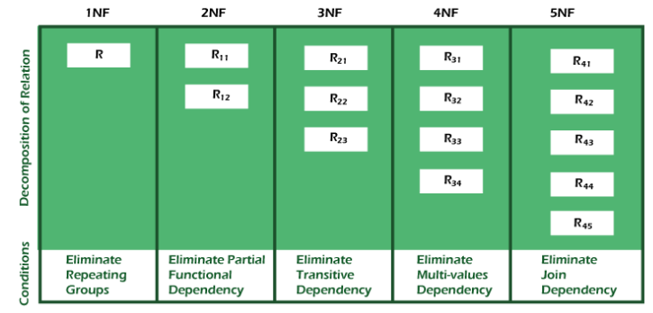
Types of Normal Forms:
Normalization works through a series of stages called Normal forms.
The normal forms apply to individual relations.
The relation is said to be in particular normal form if it satisfies constraints.

Slide 39
First Normal Form (1NF)
For a table to be in the First Normal Form, it should follow the following 4 rules:
It should only have single(atomic) valued attributes/columns.
Values stored in a column should be of the same domain
All the columns in a table should have unique names.
And the order in which data is stored, does not matter.

Slide 40
Second Normal Form (2NF)
For a table to be in the Second Normal Form,
It should be in the First Normal form.
And, it should not have Partial Dependency.

Slide 41
Third Normal Form (3NF)
A table is said to be in the Third Normal Form when,
It is in the Second Normal form.
And, it doesn't have Transitive Dependency.

Slide 42
Boyce and Codd Normal Form (BCNF)
Boyce and Codd Normal Form is a higher version of the Third Normal form.
This form deals with certain type of anomaly that is not handled by 3NF.
A 3NF table which does not have multiple overlapping candidate keys is said to be in BCNF.
For a table to be in BCNF, following conditions must be satisfied:
R must be in 3rd Normal Form
for each functional dependency ( X → Y ), X should be a super Key.

Slide 43
Fourth Normal Form (4NF)
A table is said to be in the Fourth Normal Form when,
It is in the Boyce-Codd Normal Form.
It doesn't have Multi-Valued Dependency.

Slide 44
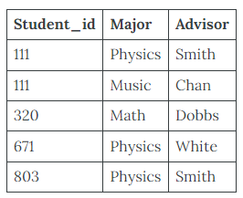
BCNF Example 1
Consider the following table (St_Maj_Adv).

Slide 45
The semantic rules (business rules applied to the database) for this table are:
Each Student may major in several subjects.
For each Major, a given Student has only one Advisor.
Each Major has several Advisors.
Each Advisor advises only one Major.
Each Advisor advises several Students in one Major.

Slide 46
The functional dependencies for this table are listed below.
The first one is a candidate key; the second is not.
Student_id, Major ——> Advisor
Advisor ——> Major

Slide 47
Anomalies for this table include:
Delete – student deletes advisor info
Insert – a new advisor needs a student
Update – inconsistencies
PK can be Student_id, Major or Student_id, Advisor.

Slide 48
To reduce the St_Maj_Adv relation to BCNF, you create two new tables:
St_Adv (Student_id, Advisor)
Adv_Maj (Advisor, Major)

Slide 49
